Slide 1
Barriers #3
Connecting

Slide 2
A Deceptively Tough Barrier
Getting connected – particularly to groups & organizations is surprisingly tough
Getting connected to other individuals or groups to counter racism can be tough, particularly for introverts
Getting connected to organizations is tougher & can be a daunting barrier

Slide 3
10 Key Points – Connecting with Individuals
Keep it Simple – may only need 1-3 people
Use Your Current Network to Start – build from there
Look for People Already Engaged in Countering Racism
Be Clear with Others About the Purpose of the Connection – achieve what together?
5. Focus on Strengths – what are you bringing?

Slide 4
10 Key Points – Connecting with Individuals
Set Regular Times to Meet with an Agenda
Take Advantage of Educational Experiences Together
Stay on Track – celebrate; learn from the experience; decide what to keep doing, start doing, and stop doing
Use the Site Together for Support
10. Work Together to Connect with Organizations

Slide 5
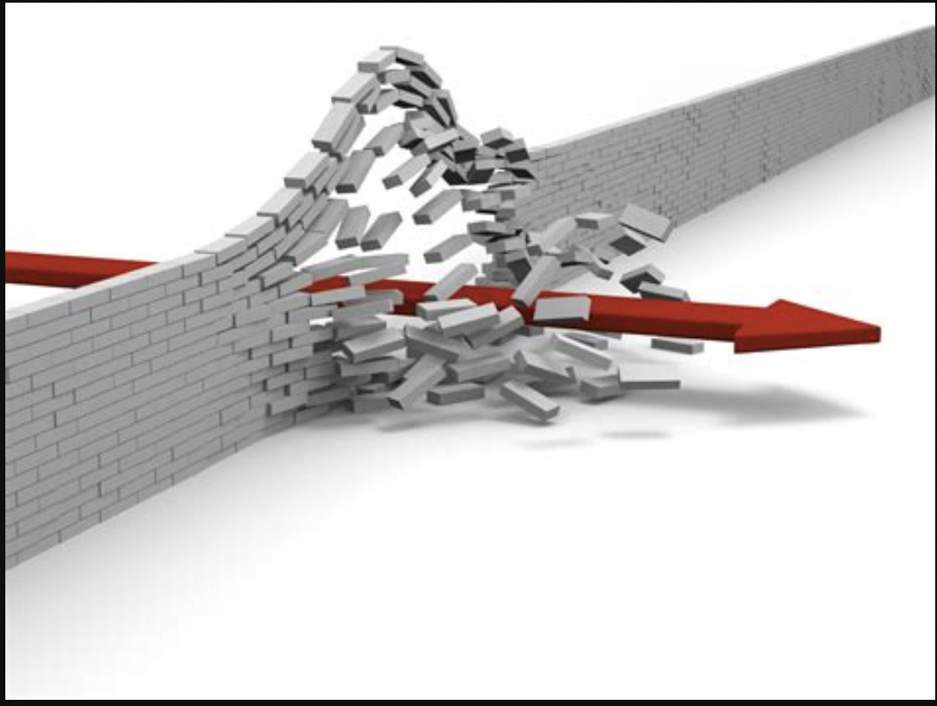

Slide 6
10 Key Points – Connecting with Organizations
This is a deceptively Tough Challenge
2. The Searching & Exploring is Part of the Commitment
This is a Question of Fit – You & the Organization
Prep Like a Job Search – Search Hard
5. Prep Like a Job Search – Prepare Your “Resume”

Slide 7
10 Key Points – Connecting with Organizations
Make it Easy for the Organization to Know Your Value
Expect Natural Ambivalence on Their Part
Use the Other Parts of the Site to Prep for the Search
Combine Your Actions Across Multiple Organizations
10. Do This With Others

Slide 8
“There is no power for change greater than a community discovering what it cares about.”
Margaret J. Wheatley

